Slide 1

CALL CENTRE
www.slidesgo.es
DASHBOARD
Malleshwari Bhimanpalli

Slide 2
TABLE OF CONTENTS
01
02
03
04
INTRODUCTION
OBJECTIVE
CONCEPTS
PROBLEM STATEMENT
05
DASBOARDS

Slide 3
INTRODUCTION
The Call Centre dataset contain detailed information about Total Calls, including specifics about the calls by state, reason, sentiment, dates, city and channel

Slide 4
OBJECTIVE
The object of this project is to create a call centre dashboard that can be used to track a variety of call centre metrics. The dashboard is designed to be easy to use and can be used to track the number of calls, the duration of calls, the response time, and the percentage of calls that are answered within a certain timeframe. The dashboard also includes a breakdown of calls by day, channel, call centre city, reason for call, sentiment, and state.

Slide 5
CONCEPTS
This dynamic and intuitive tool is designed to revolutionize the way call center operations are managed, bringing efficiency and productivity to a whole new level. With the Call Centre Dashboard, you can now effortlessly monitor key metrics, such as call volume, average handling time, customer satisfaction, and agent performance, all in real-time.

Slide 6

PROBLEM STATEMENT
We need to analyze key indicators (KPI’s) for our Call Centre data to gain insights into our business performance such as:
Total Number of Calls
Total Call Duration (Hrs)
Total Call Duration (MM)
Avg Call Duration (Min)
Total Calls by Day
Total Calls by State
Total Calls by Reason
Total Calls by Sentiment
Total Calls by Channel
Total Calls by Call-Centres City

Slide 7


Slide 8
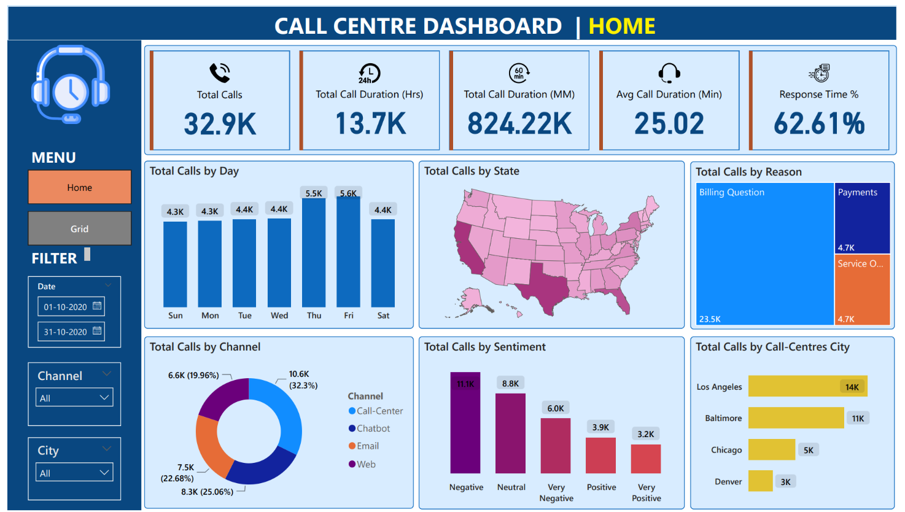
DASHBOARD

Slide 9
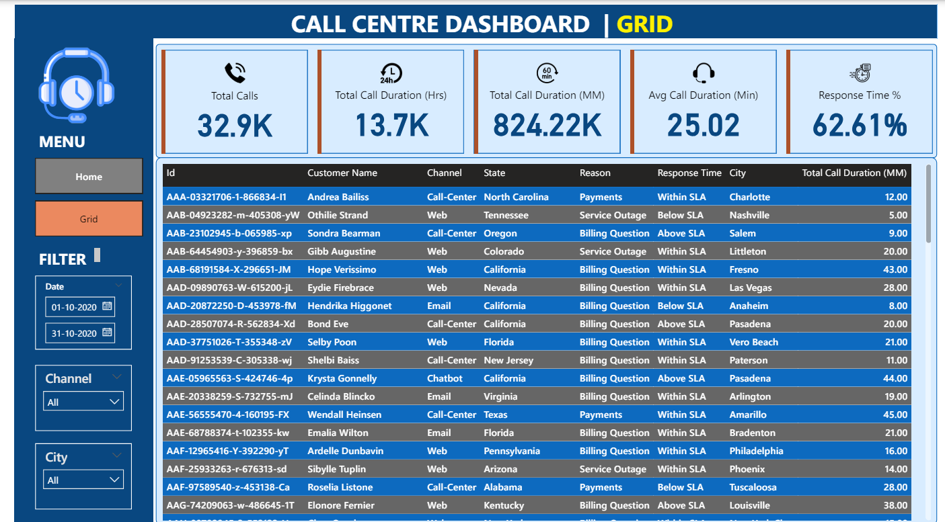
DASHBOARD

Slide 10


THANKS!

